Slide 1
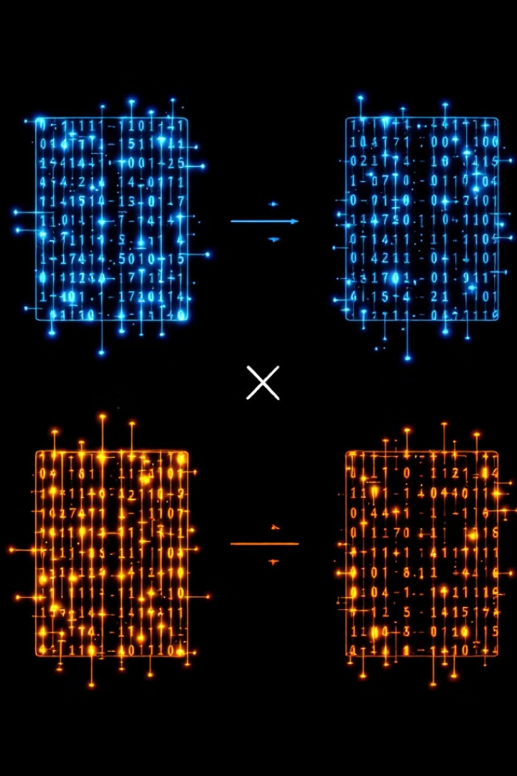
Matrix Multiplication Using Hadoop MapReduce
This presentation explores distributed matrix computation using Hadoop MapReduce. We'll dive into the implementation, challenges, and benefits of this big data approach.

Slide 2

Introduction
1
Challenge
2
Objective
Traditional matrix multiplication methods struggle with big data volumes. Hadoop MapReduce offers a scalable solution.
Implement efficient, large-scale matrix multiplication using distributed Hadoop framework.
3
Significance
Enables processing of matrices beyond single-machine memory limits. Showcases Hadoop's power in real-world computations.

Slide 3

Input and Output Data Format
Input Format
MatrixName, RowIndex, ColIndex, Value
Example Input A
A,0,0,25, A,0,1,9
Example Input B
B,0,0,44, B,1,0,13
Output Format
RowIndex, ColIndex, Value
Example Output
0,0,841, 1,0,1493

Slide 4
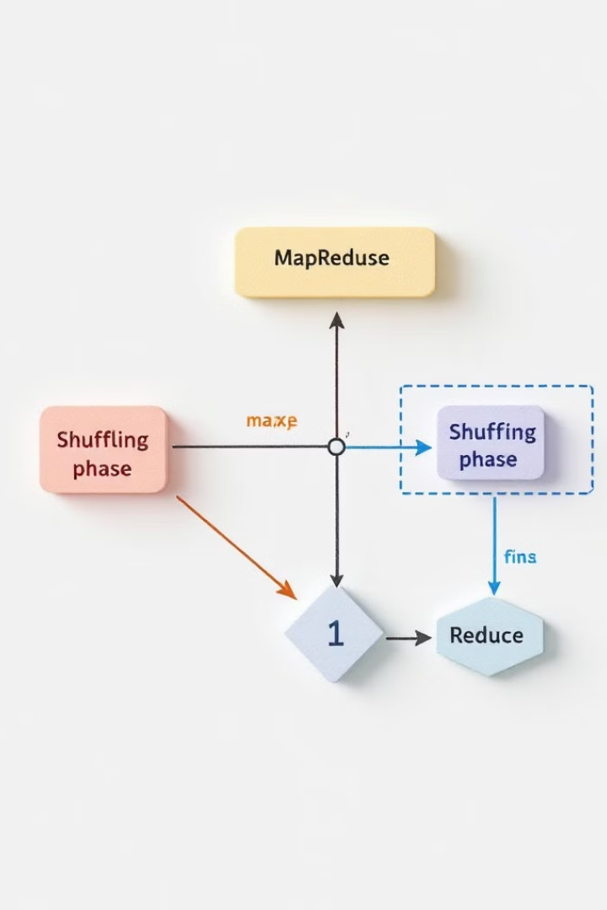
MapReduce Workflow
1
Mapper Phase
Reads input, emits key-value pairs. Generates keys for all possible result cells.
2
Shuffle and Sort
Hadoop groups Mapper outputs by keys, preparing for Reducer phase.
3
Reducer Phase
Aggregates values, computes dot products, outputs final cell values.

Slide 5




Driver Code
Configuration
Sets HDFS paths, passes matrix dimensions via Configuration object.
Job Setup
Links Mapper and Reducer classes, configures input/output formats.
Execution
Submits job, monitors progress, handles completion or failure.

Slide 6
Mapper Code
Key-Value Generation
Example
Efficiency
Creates pairs identifying result matrix cells. Encodes matrix info for Reducer use.
Input A,0,0,25 generates Key: (0,0), Value: ("A",0,25).
Prepares data for distributed processing. Handles unordered, scattered input seamlessly.

Slide 7

Reducer Code
Aggregation
Computation
Groups values by keys representing result matrix cells.
Calculates dot products for each cell using aggregated data.
Output
Optimization
Emits final computed value for each result matrix cell.
Utilizes efficient data structures like HashMap for quick lookups.

Slide 8
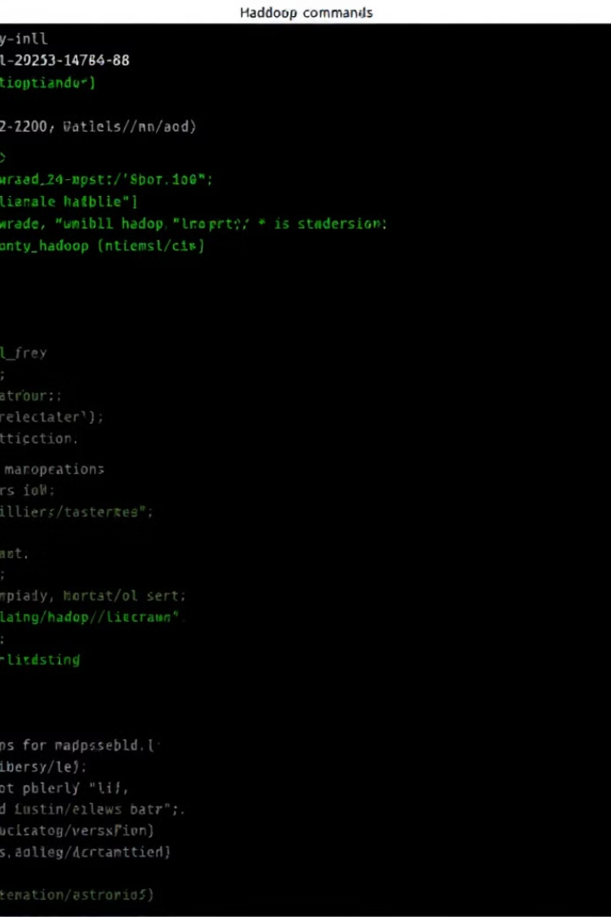
Execution Steps
1
Compilation
Compile Java code with Hadoop classpath.
2
HDFS Preparation
Create directories, upload input matrices to HDFS.
3
Job Execution
Run Hadoop jar with appropriate parameters.
4
Result Retrieval
Fetch and analyze output from HDFS.

Slide 9

Results
Input A
A,0,0,25, A,0,1,9
Input B
B,0,0,44, B,1,0,13
Output C
0,0,841, 1,0,1493
Verification C[0,0]
(25×44)+(9×13)=841
Verification C[1,0]
(31×44)+(17×13)=1493

Slide 10




Conclusion and Learnings
Achievements
Challenges
Future Work
Implemented scalable matrix multiplication using Hadoop MapReduce.
Optimized data shuffling and reducer logic for efficient distributed computation.
Extend to other relational operations. Optimize for larger matrices with advanced indexing.

